Slide 1
Imaging
ITEE Summer of AI
Dr. Shekhar “Shakes” Chandra

Slide 2
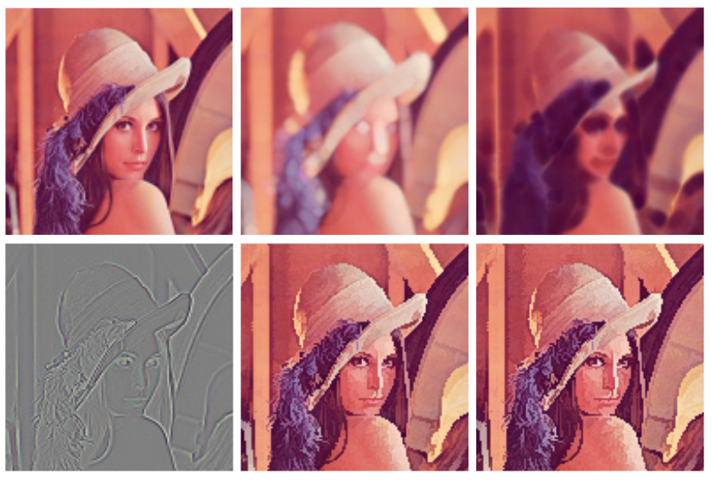
Images
Grid of values holding intensities or measurements (ixels, pixels, voxels etc.)
Spatial correlation between these values have some meaning to the problem
We can process the neighbourhoods of these values to determine gradients, flow, PDEs, texture, edges, colour, density
1000s of algorithms for processing images, it’s an entire field on its own!
120 | 222
84 | 32
A. S. Boroujerdi, M. Breuß, B. Burgeth, and A. Kleefeld, “PDE-Based Color Morphology Using Matrix Fields,” in Scale Space and Variational Methods in Computer Vision, Cham, 2015, pp. 461–473, doi: 10.1007/978-3-319-18461-6_37.
#summer-of-ai

Slide 3
Imaging – The Traditional Way
Handcraft features
Tune parameters
Obtain Results
The human has to do everything step-by-step
Study the data and know what to look for
Find the relevant features for dataset
Find the algorithms that extract those features (edges, textures etc.)
Tune the parameters of the features and algorithm
Obtain the results and hope the performance is good
Gain insight from the results and why its not so good
Handcraft better features and repeat!
#summer-of-ai

Slide 4
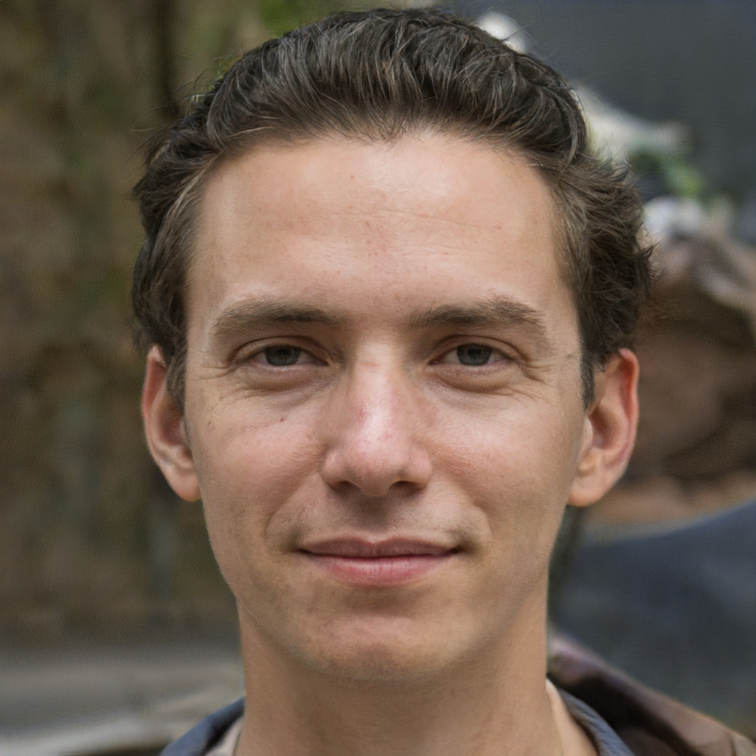
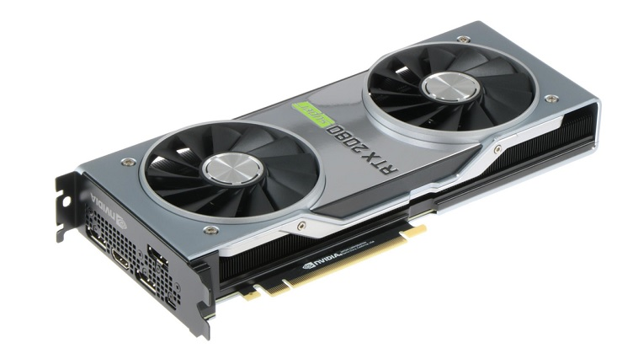
‘AI’ in imaging today …
https://thispersondoesnotexist.com/
Live transcribing
Digital assistants
Recommendations
Face recognition
Augmented Reality
Etc.
Google
Microsoft
Amazon
Facebook
OpenAI
Samsung
Apple
Etc.
Deep Learning
Graphical Processing Units (GPUs) – 10 TeraFLOPS
Imagined by a GAN (generative adversarial network) StyleGAN2
So what?!
Same algorithm in deep learning runs at least 20-30 times faster
15-20% more accurate/performance
Directly solves the problem
Completely data-driven, no need to have an expert of the data
This is what WE build and do!
Open source frameworks!
Artificial Neural Networks
Artificial neurons make non-linear decisions when connected together
This network decides what task it can complete successfully
The weights between neurons parameterizes the entire problem!
Designing new networks is the main driver of AI innovation
Notes:
CPU i7 – 180 GFLOPS,

Slide 5
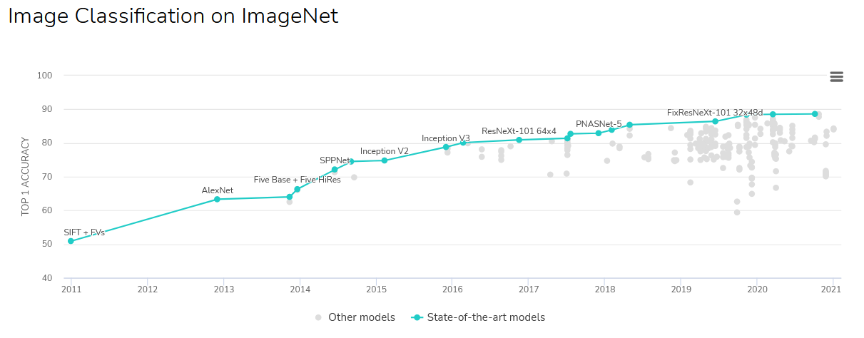
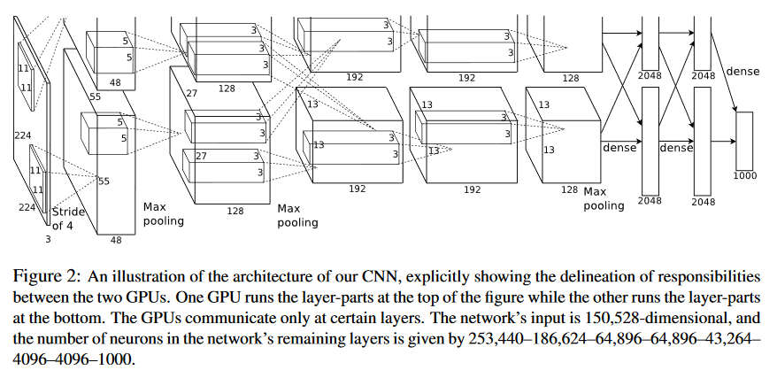
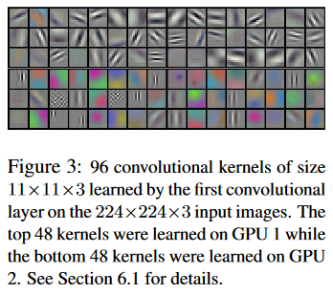
AlexNet
The network that started it all! Next level image classification performance and understanding using CNNs
https://paperswithcode.com/sota/image-classification-on-imagenet
A. Krizhevsky, I. Sutskever, and G. E. Hinton, “ImageNet Classification with Deep Convolutional Neural Networks,” in Advances in Neural Information Processing Systems 25, F. Pereira, C. J. C. Burges, L. Bottou, and K. Q. Weinberger, Eds. Curran Associates, Inc., 2012, pp. 1097–1105.
#summer-of-ai

Slide 6
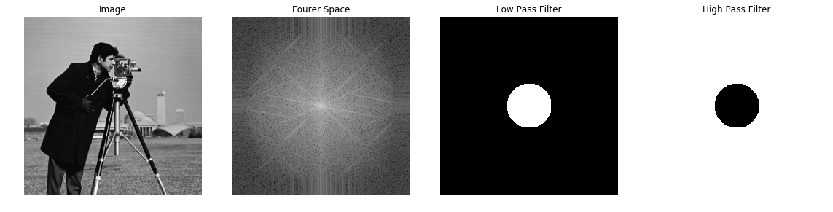
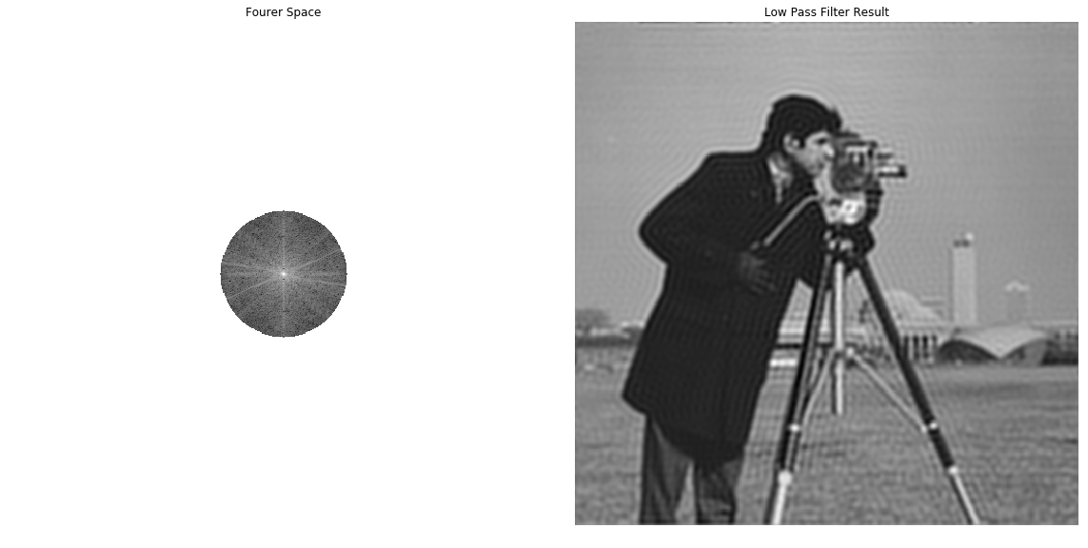
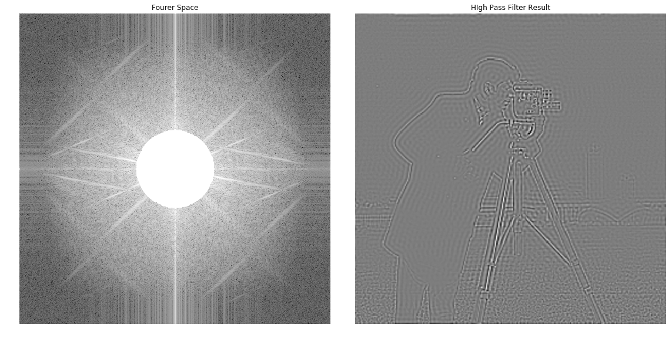
Filtering
Fourier space has many advantages, including filtering and convolution
#summer-of-ai

Slide 7
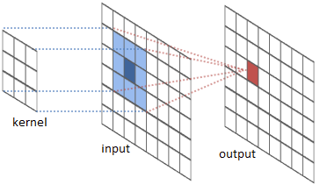


Image Convolution
Links
http://colah.github.io/posts/2014-07-Understanding-Convolutions/
https://towardsdatascience.com/a-comprehensive-guide-to-convolutional-neural-networks-the-eli5-way-3bd2b1164a53
#summer-of-ai

Slide 8

Convolutional Neural Networks (CNN)
CNN is a class of deep learning models that specialise on image processing.
CNNs perform feature extraction via convolution with trainable filters.
Stacked Convolutional layers can perform hierarchical feature featraction
Earlier layer extract fine grained details such as edges,
Deeper layer extract abstract features such as objects and patterns.

Slide 9
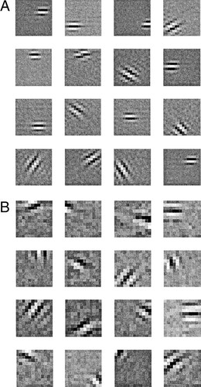
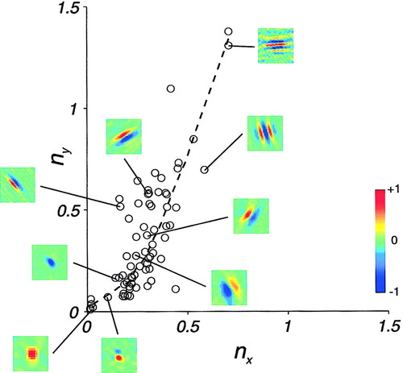
Receptive Fields
Mammalian vision system uses response functions called receptive fields
These fields are spread out across the visual inputs and been linked to Gabor filters [1] and controls the neural firing within the visual cortex
We compute them using convolution
Example of the receptive fields of a Macaque's primary visual cortex and their distribution with respect to spatial parameters [2]
Modelled
Field
Gabor
Filters
Actual
Field
[1] B. A. Olshausen and D. J. Field, “Emergence of simple-cell receptive field properties by learning a sparse code for natural images,” Nature, vol. 381, no. 6583, p. 607, Jun. 1996.
[2] D. L. Ringach, “Spatial Structure and Symmetry of Simple-Cell Receptive Fields in Macaque Primary Visual Cortex,” Journal of Neurophysiology, Jul. 2002.

Slide 10
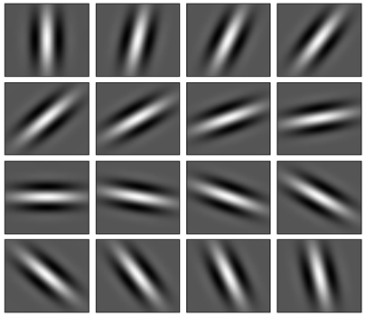
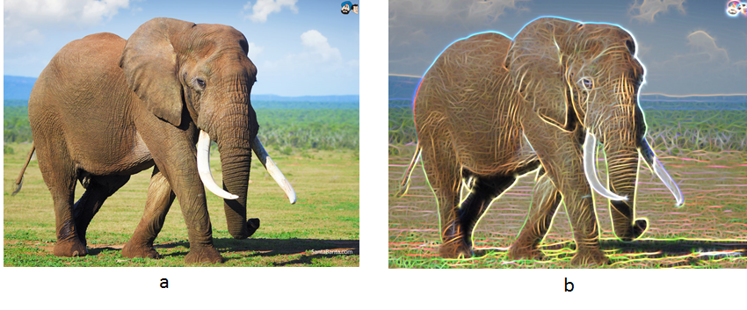
Receptive Fields
https://medium.com/@anuj_shah/through-the-eyes-of-gabor-filter-17d1fdb3ac97
We compute them using convolution
Gabor Filters
#summer-of-ai

Slide 11

Convolution Neural Networks (CNNs)
https://en.wikipedia.org/wiki/Convolutional_neural_network
The CNN mimics the human vision system by computing a set of receptive fields across the visual inputs at multiple scales called layers.
Responses from a previous layer with smaller scales are passed on to the subsequent layer with a larger scale by averaging or pooling the responses at this layer.
In this way, the initial layers pass on smaller finer details for the higher layers to receive and respond.
The higher layers respond to these pooled or aggregated responses resulting in responses to larger scale structures.
#summer-of-ai

Slide 12
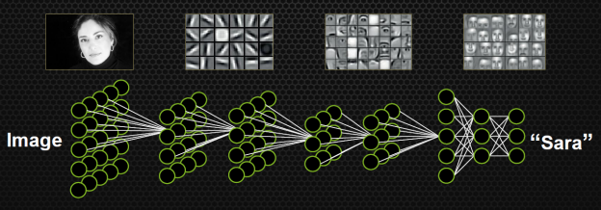
Convolution Neural Networks
https://devblogs.nvidia.com/accelerate-machine-learning-cudnn-deep-neural-network-library/
#summer-of-ai

Slide 13
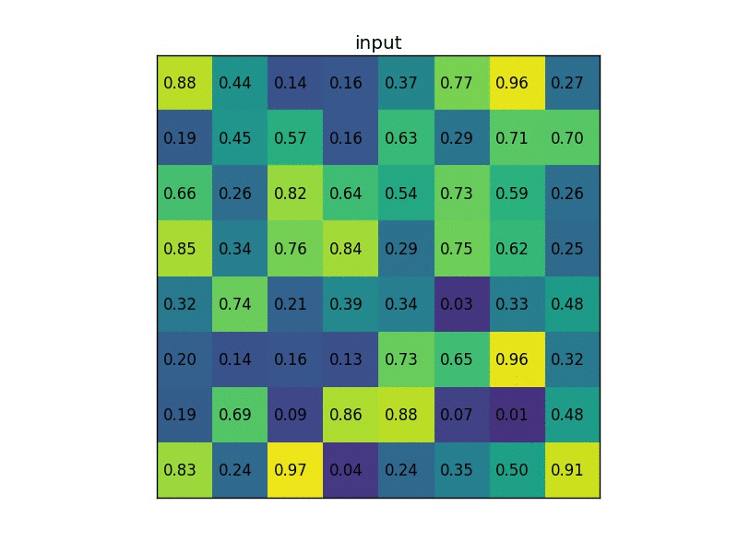
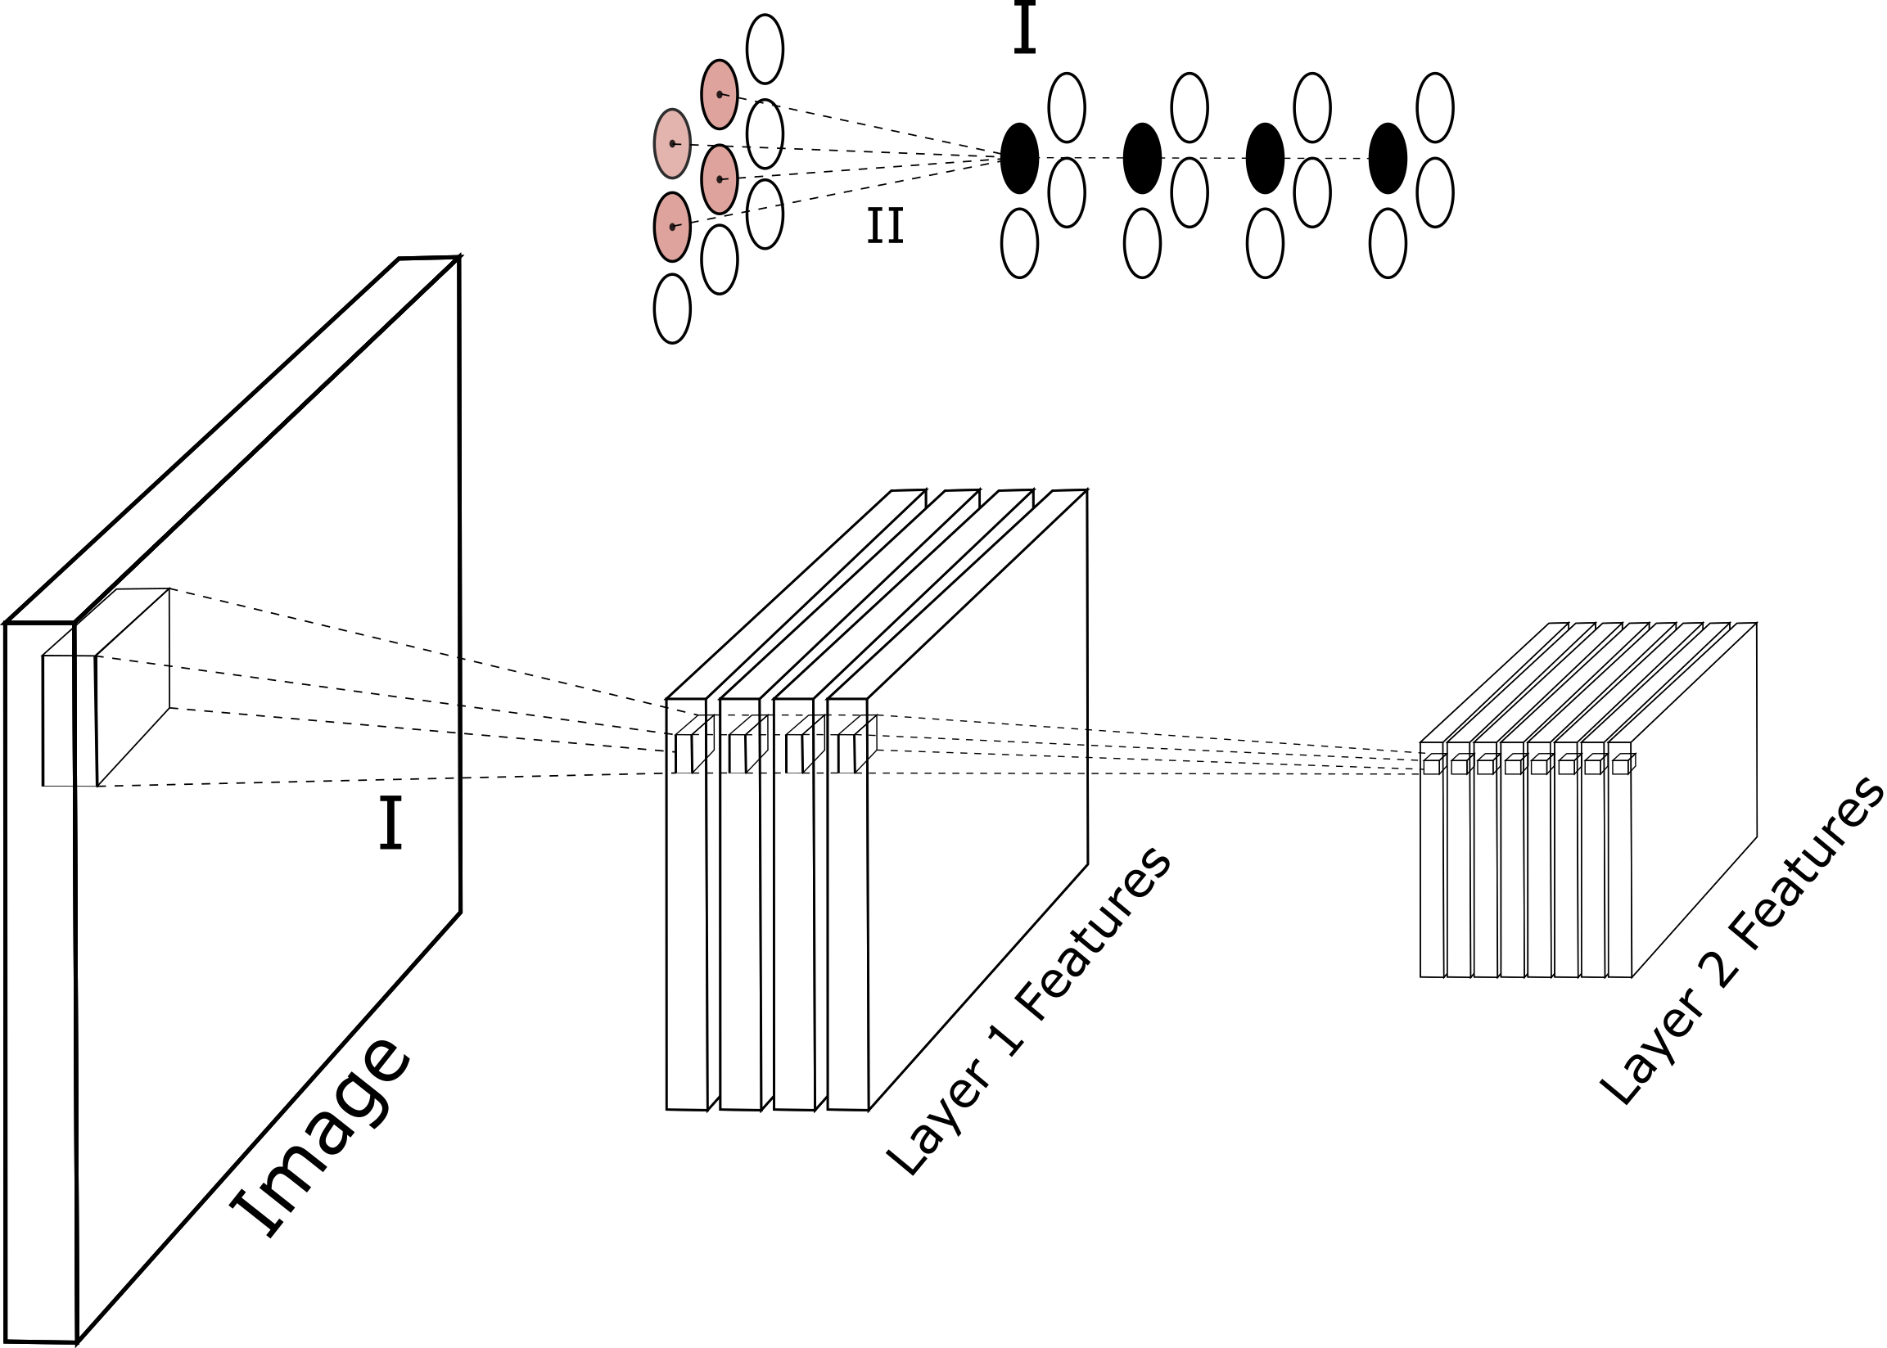
Convolution Neural Networks
We learn the optimal filters responsible for our desired task by optimizing the receptive field responses to network input and output.
Schematic of a CNN encoder. Inset I shows the receptive field and II the pooling of the responses into the subsequent convolutional layer.
#summer-of-ai

Slide 14
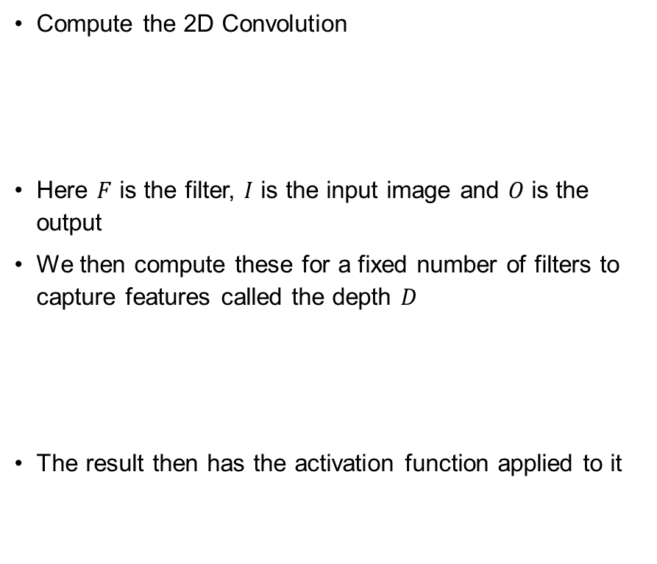
Convolution Neural Networks
We learn the optimal filters responsible for our desired task by optimizing the receptive field responses to network input and output.
Compute the 2D Convolution
Here $F$ is the filter, $I$ is the input image and $O$ is the output
We then compute these for a fixed number of filters to capture features called the depth $D$
The result then has the activation function applied to it
Schematic of a CNN encoder. Inset I shows the receptive field and II the pooling of the responses into the subsequent convolutional layer.
#summer-of-ai

Slide 15
#summer-of-ai

Slide 16
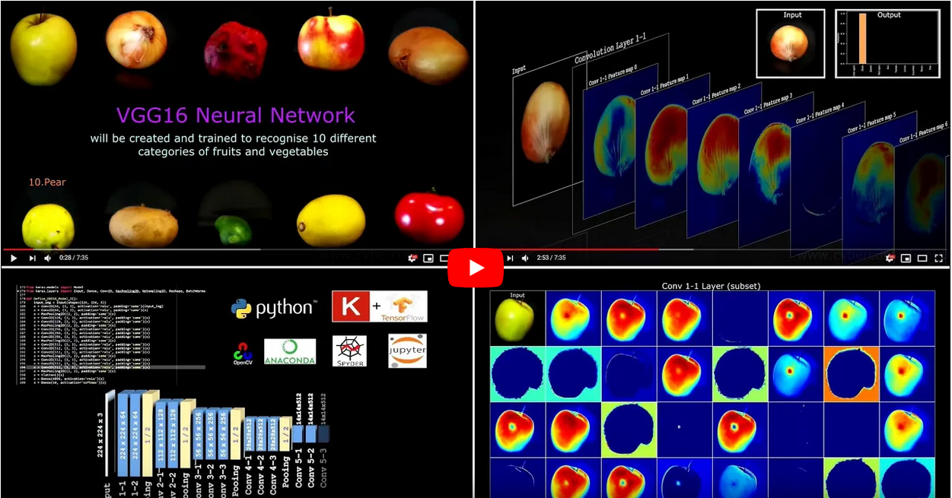
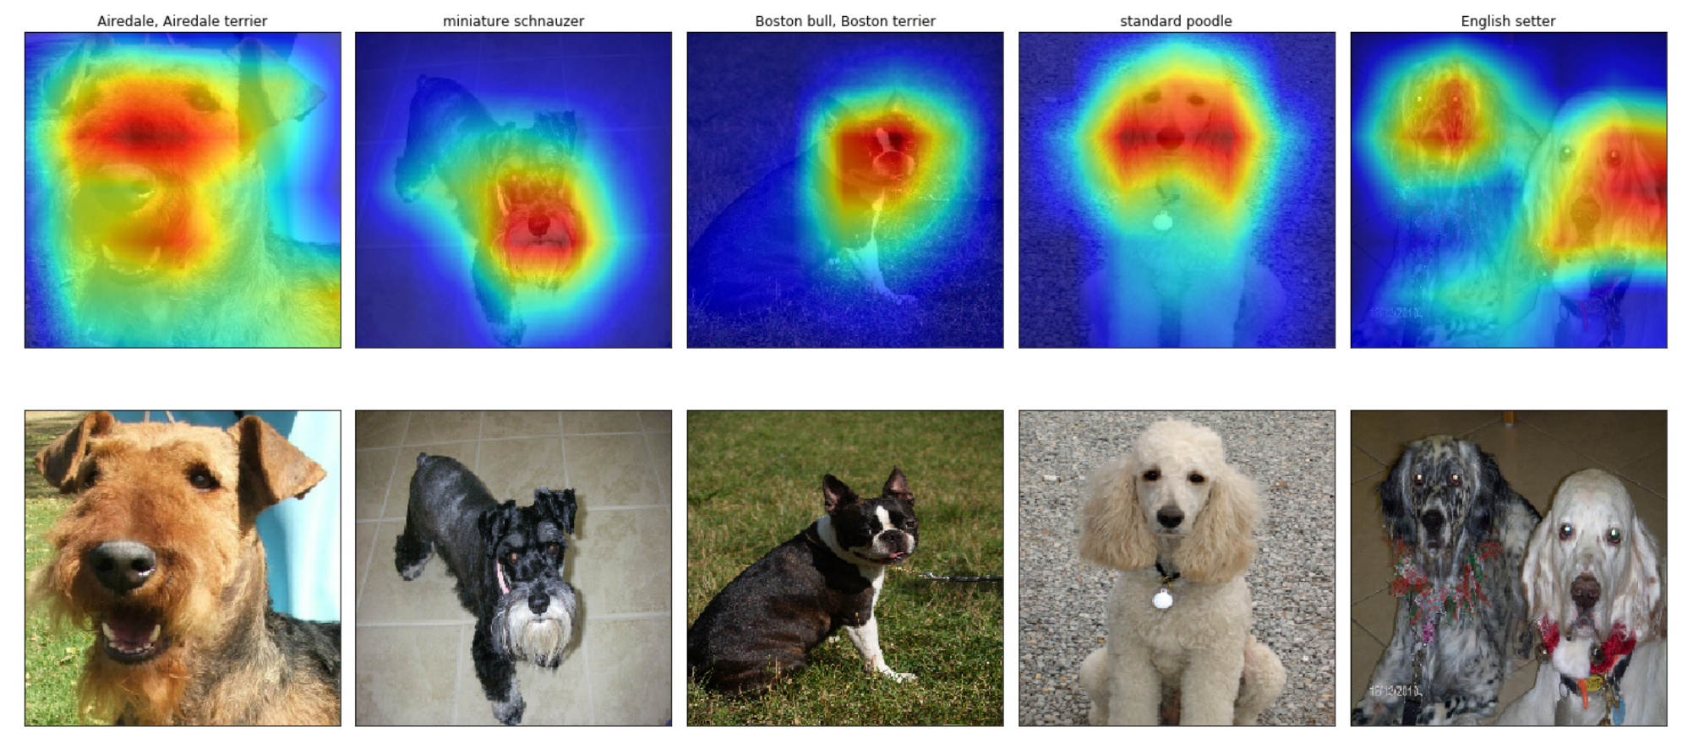
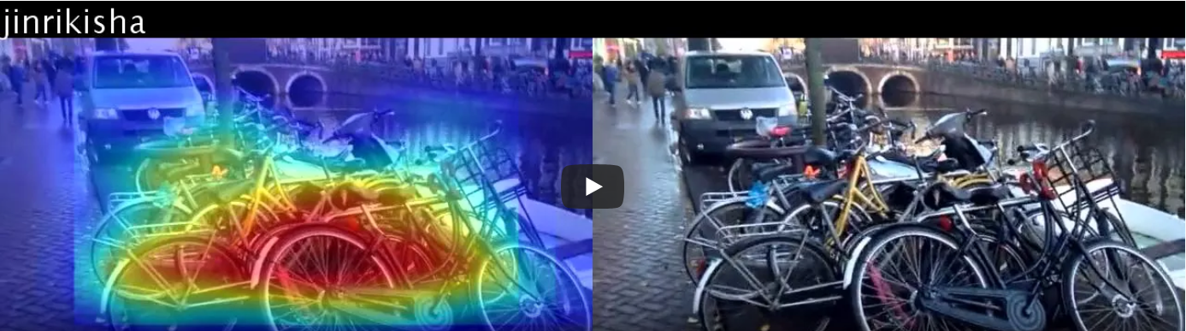
Data-driven - automation
The learnt weights of the network define the function of the network.
At the same time, it automatically extracts features in the input that it uses
https://alexisbcook.github.io/2017/global-average-pooling-layers-for-object-localization/

Slide 17
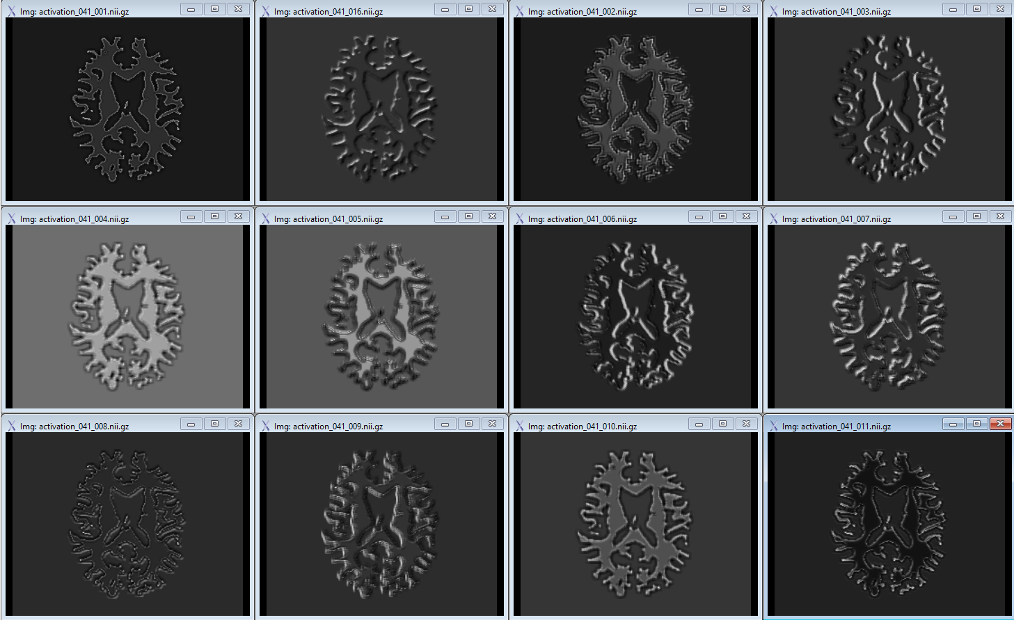
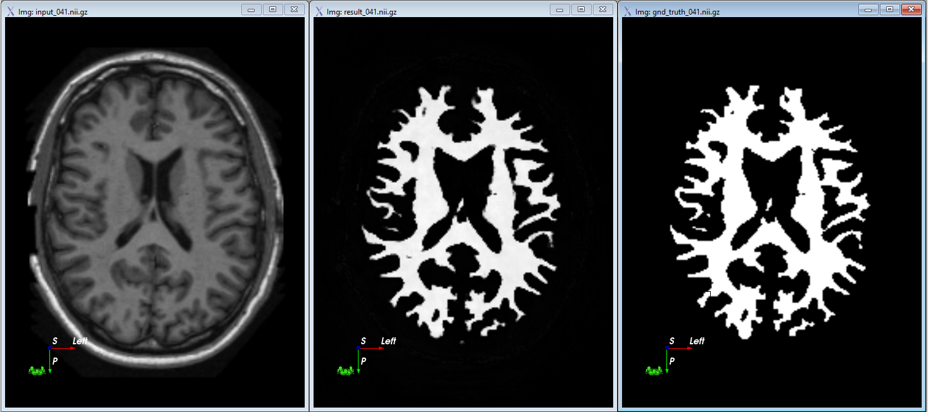
Activation Maps
https://github.com/philipperemy/keract
For given sample inputs, visualise what parts of the images cause activations in our choice of layer.
#summer-of-ai

Slide 18
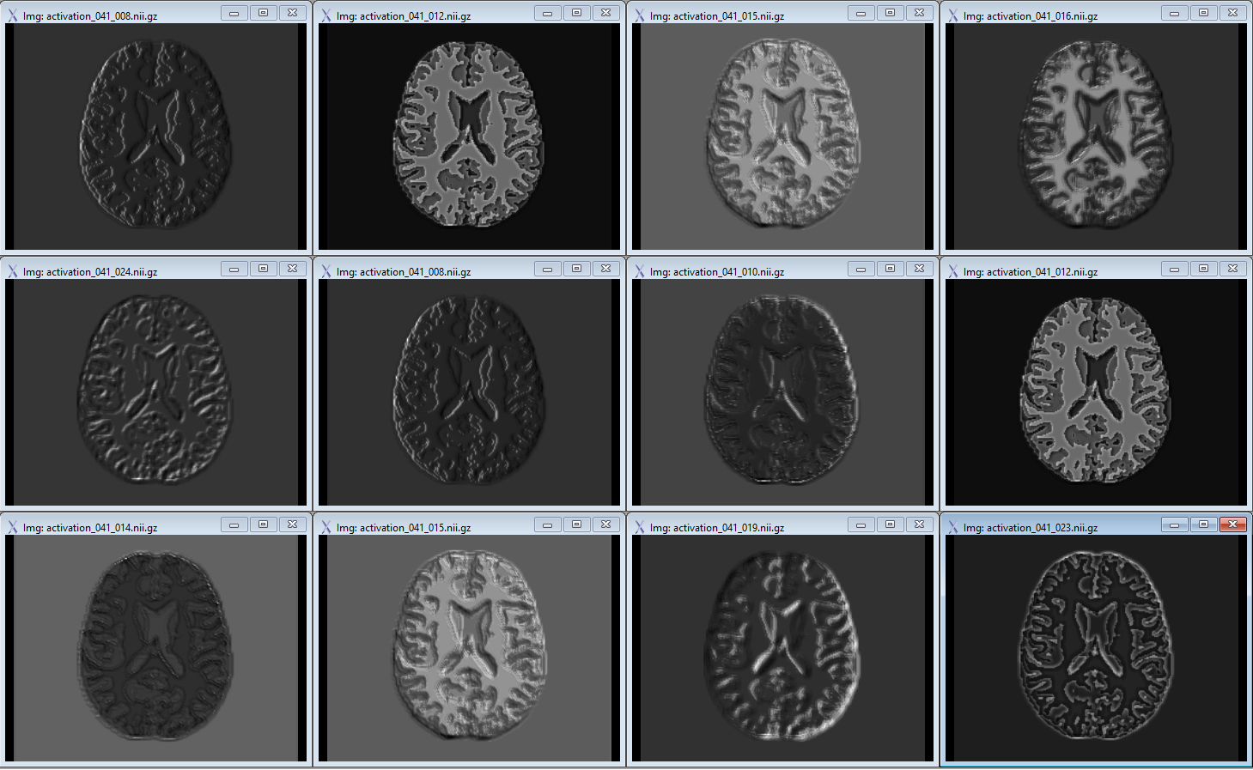
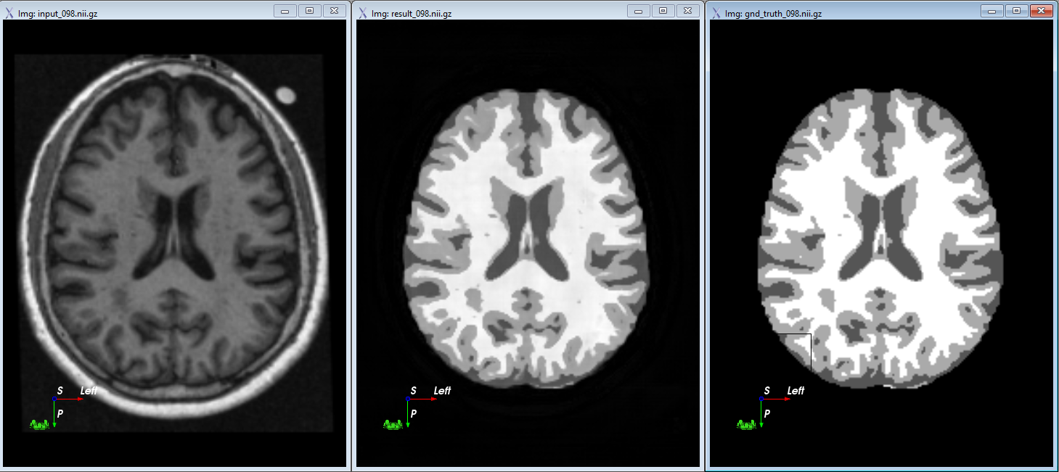
Activation Maps
https://github.com/philipperemy/keract
For given sample inputs, visualise what parts of the images cause activations in our choice of layer.
#summer-of-ai

Slide 19
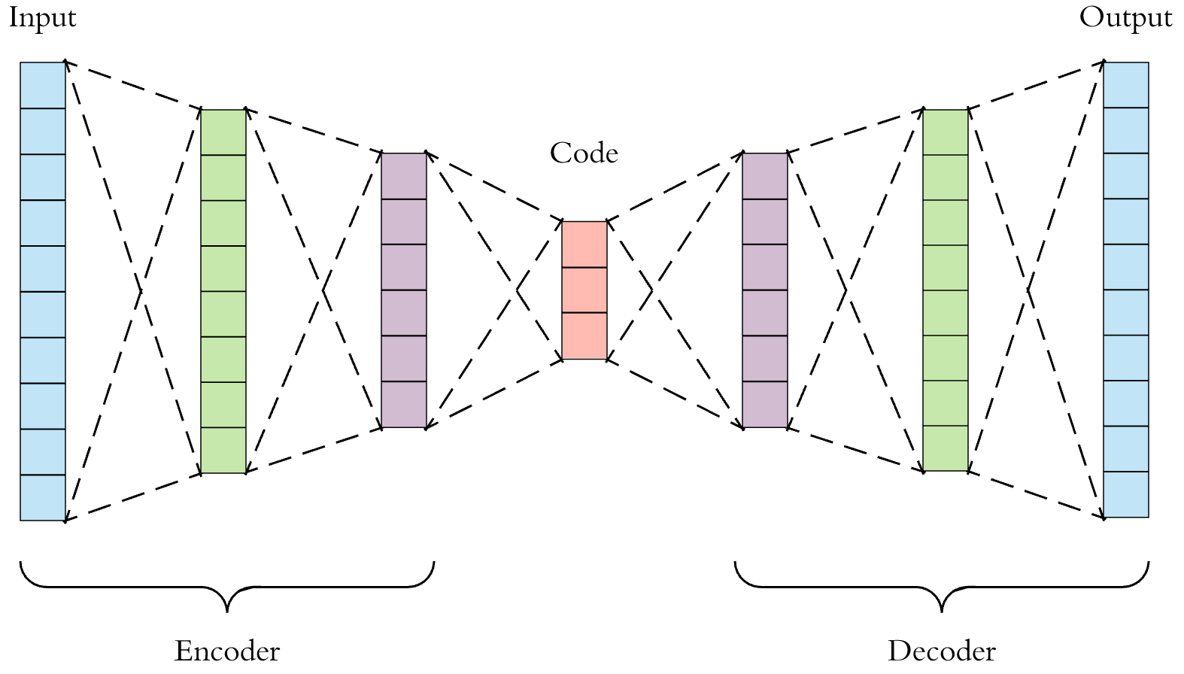
Autoencoder – Deep Learning
https://towardsdatascience.com/applied-deep-learning-part-3-autoencoders-1c083af4d798
See also https://blog.keras.io/building-autoencoders-in-keras.html
Deeper
#summer-of-ai

Slide 20
Skip Connections - UNet
Skip Connections
#summer-of-ai

Slide 21

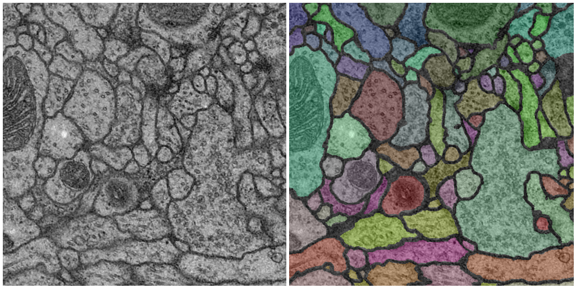
Skip Connections - UNet
https://lmb.informatik.uni-freiburg.de/people/ronneber/u-net/
A standard CNN autoencoder with skip connections. The skip connection prevent information loss. Ideal for segmentation tasks
#summer-of-ai

Slide 22
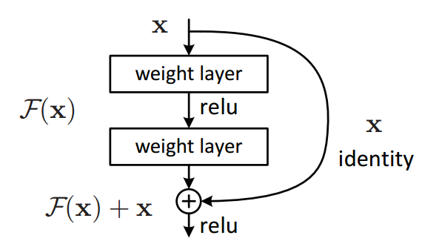
Residual Connections - ResNet
https://arxiv.org/abs/1512.03385
A skip connection where we ensure that the parameters learnt correspond to the difference or residual of the result at each layer.
Learning residuals means there is no loss of precision and gradients vanishing because differences are lost among large values
Residual connections allow for deeper networks as a result
The original ResNet broke records for computer vision prize for the deep networks having hundreds of layers
Residual connections are usually quite easy to add to most network architectures
#summer-of-ai

Slide 23
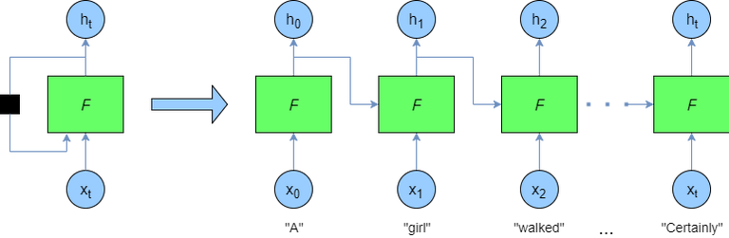
Recurrent Connections – RNNs
https://doi.org/10.1109/TPAMI.2008.137
A recursive or loop connection is made back to the start of network
Well suited for time series or sequential data
Sometimes used as a way to iteratively apply a network to a problem
Recurrence can also be used to ‘store’ memory and maintaining an internal state
https://adventuresinmachinelearning.com/recurrent-neural-networks-lstm-tutorial-tensorflow/
#summer-of-ai

Slide 24
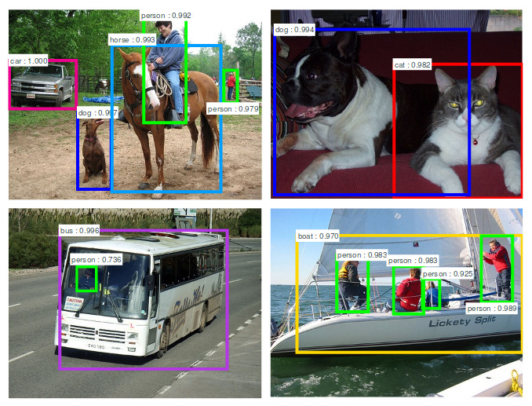
Region CNNs – R-CNNs and Faster R-CNNs
https://arxiv.org/abs/1506.01497
Uses a CNN to generate regions or bounding boxes around objects desired
This region proposal network can then be classified into objects
Robust to occlusion since boxes can pick up and ignore partial coverage
#summer-of-ai

Slide 25
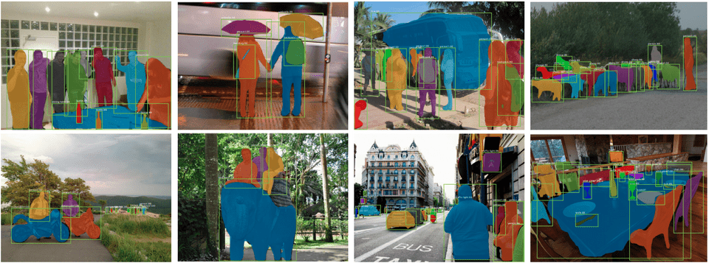
Region CNNs (RCNNs)
RCNNs provide fast region based detector of ROIs (~1-10 Frames Per Second) in 2D.

Slide 26
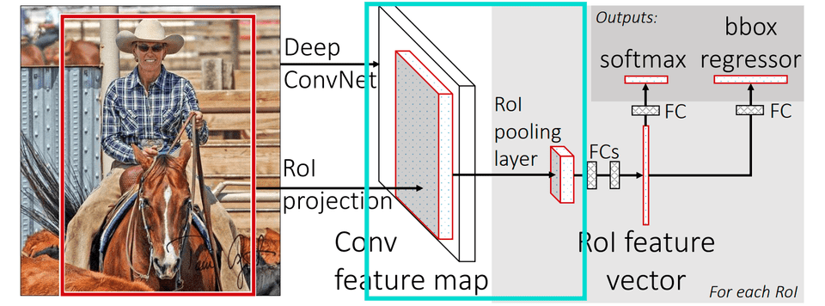
Region CNNs (RCNNs)
They use a feature extractor, region proposal network, region based pooling of these features and a regressor to evaluate quality of the candidate regions

Slide 27
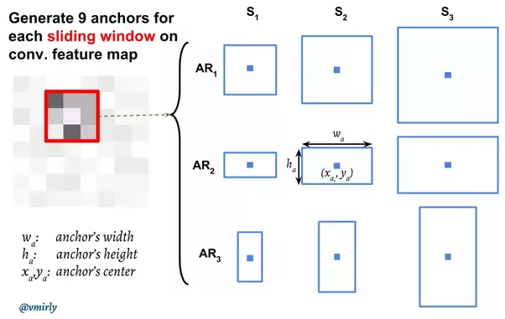
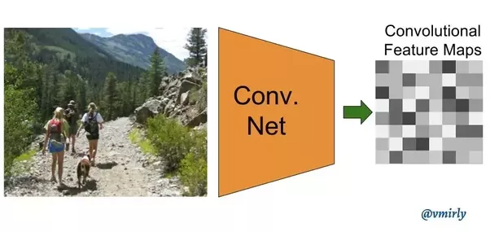
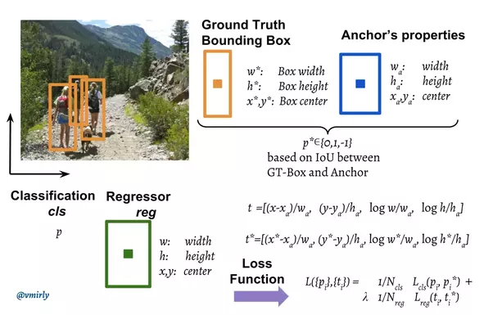
Region CNNs (RCNNs)
The feature extractor is a CNN with downsampling/pooling to create the feature space. Each object has a fixed bounding box and this is searched for in the feature map by generating an anchor for each possible object box – ROI Align.
Vahid Mirjalili, Co-author of Python Machine Learning (2nd Ed.). See this post.

Slide 28
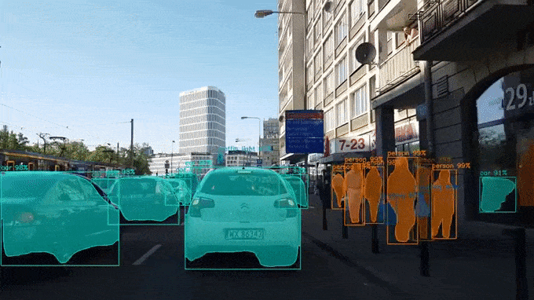
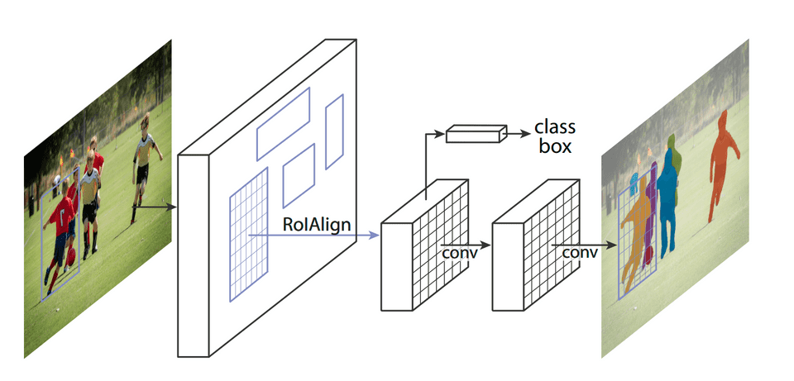
Mask RCNN
https://github.com/matterport/Mask_RCNN
K. He, G. Gkioxari, P. Dollár, and R. Girshick, “Mask R-CNN,” in 2017 IEEE International Conference on Computer Vision (ICCV), Oct. 2017, pp. 2980–2988, doi: 10.1109/ICCV.2017.322.
An improved RCNN with sub networks for computing the segmentations given the boxes found by the RCNN component. It is not only able to run fast, but also do semantic segmentation, handle occlusion and articulation.
H. Min et al., “Fully automatic computer-aided mass detection and segmentation via pseudo-color mammograms and Mask R-CNN,” arXiv:1906.12118 [cs], Jun. 2019, Accepted ISBI 2020. Available: http://arxiv.org/abs/1906.12118.

Slide 29
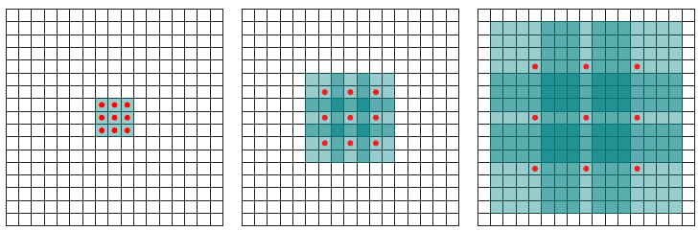

Dilated Convolutions – Context Aggregation
https://arxiv.org/abs/1511.07122
Using convolutions with ‘holes’ to average out responses to filters
Reduces the number of parameters drastically
Difficult to interpret and visualise the resulting feature maps
#summer-of-ai

Slide 30
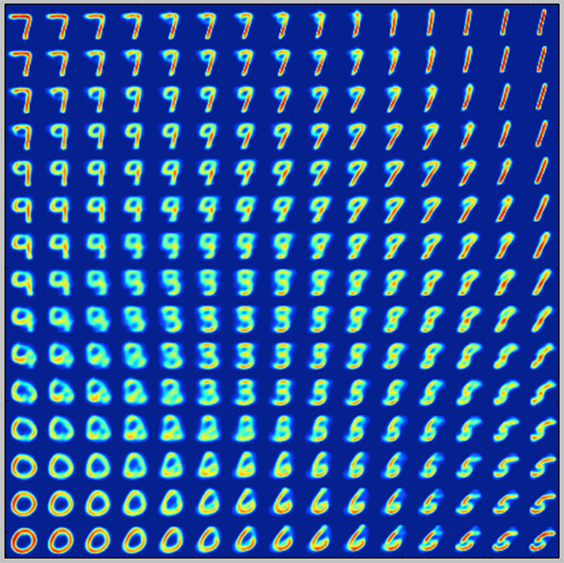
Generative Models – Variational Bayes
https://blog.keras.io/building-autoencoders-in-keras.html
Instead of fitting your network to your data directly and assuming an underlying code or representation is found, fit your data to a probability distribution
This distribution will then be a latent variable model of your data
Constraints the learning to a prior distribution and there you learn the distribution, not just the model
You can then use the distribution to generate data similar to the training set with far more generalisability
The distribution of digits learnt on the right shows how one can ‘interpolate’ from one digit to the next through the Variational Autoencoder constructed using this method
#summer-of-ai

Slide 31
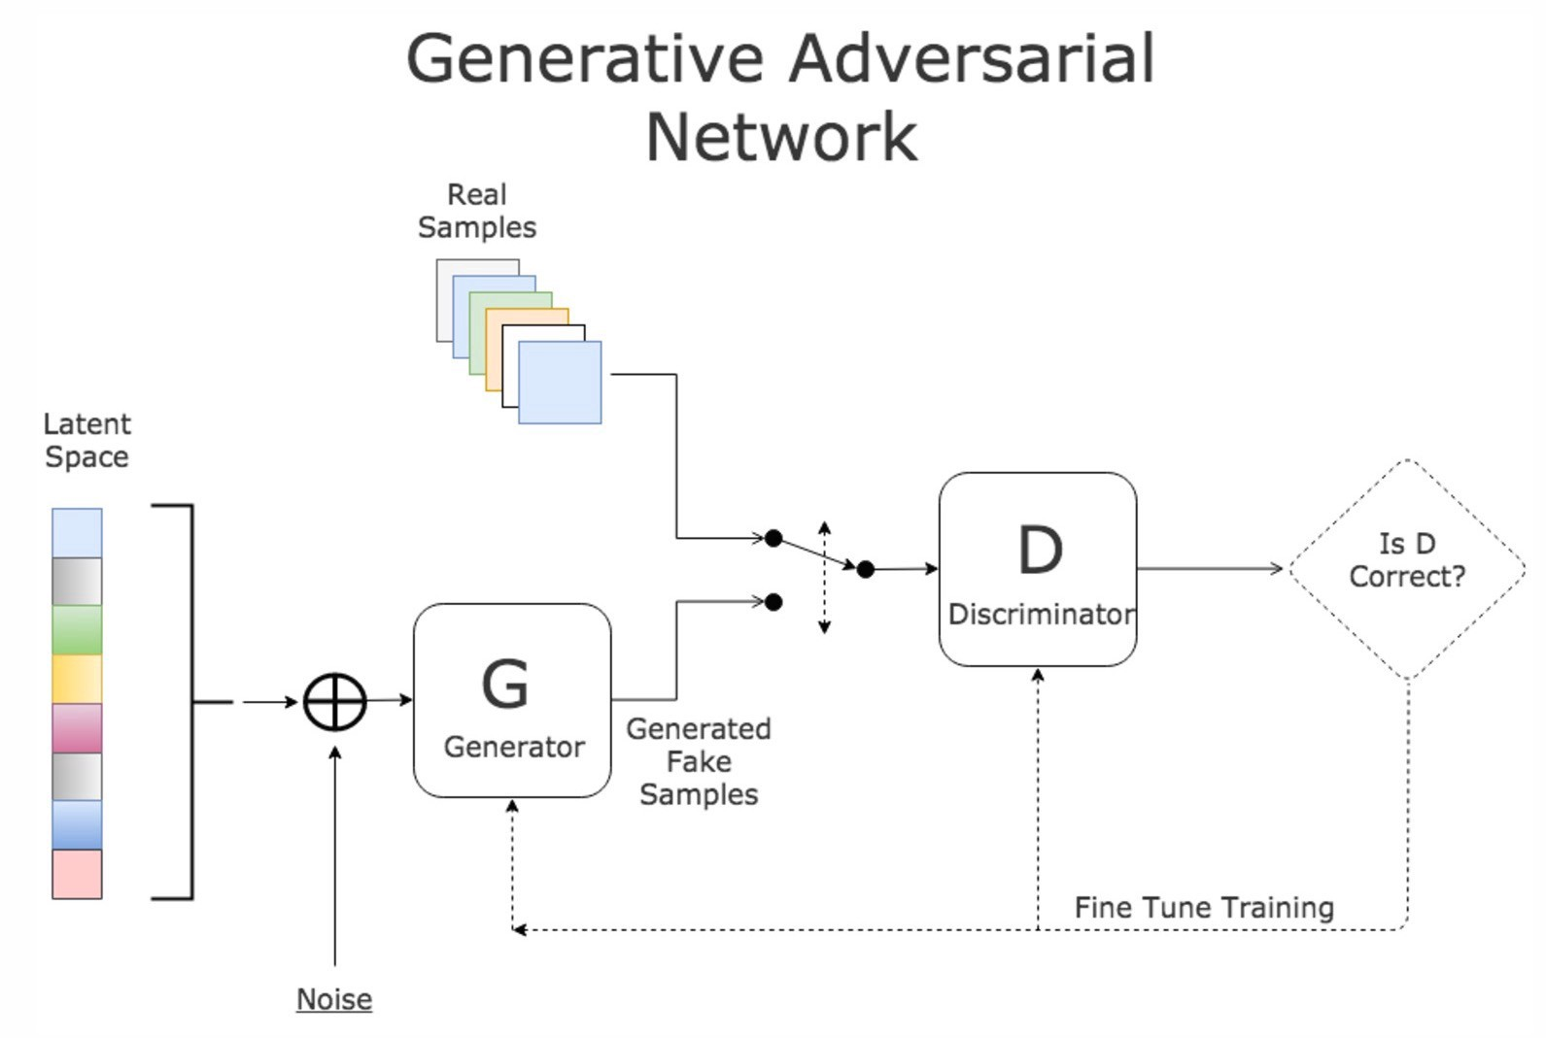
Generative Models – Adversarial Learning
https://skymind.ai/wiki/generative-adversarial-network-gan
We build a generator network attempts to fool a discriminator network into thinking that the data it produces is real
If successful, the result is a network that is capable of generating ‘realistic’ looking data
A typical Generative Adversarial Network (GAN) setup is shown right
Very powerful technique that is capable of astonishing results
Learns the underlying distribution by learning the optimal ‘overall’ cost function
Very difficult to train and often requires conditions and regularisation
#summer-of-ai

Slide 32
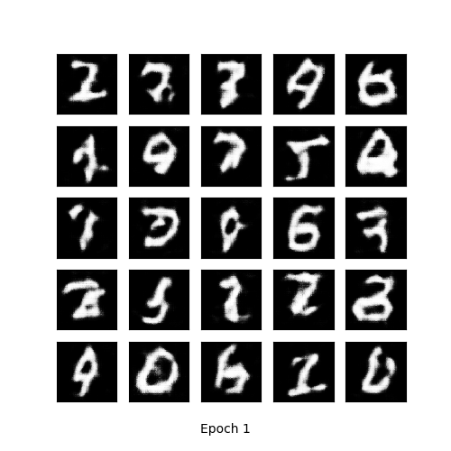
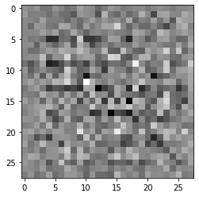
Generative Adversarial Networks
Generative Adversarial Networks (GAN) is a min-max game, where two nets try to find the Nash equilibrium of losses
G’
Real Image
Generate Fake Images with G
Train D on Real Images
Train D on Fake Images
Train G’ on Fake Images Pretending they are Real
D
1
Real
Generator
0
Fake
G
Discriminator
Noise
Fake Image
Three most significant
bone shape modes

Slide 33
Generative Adversarial Networks – Train G’
There is an adversarial loss term between D and G. We minimize D but maxmise G. This makes it adversarial learning.
Generate Fake Images with G
Train D on Real Images
Train D on Fake Images
Train G’ on Fake Images Pretending they are Real, i.e. D is fixed
G’
Real Image
D
1
Real
Generator
0
Fake
G
Discriminator
Weights Fixed
Noise
Fake Image
Three most significant
bone shape modes

Slide 34
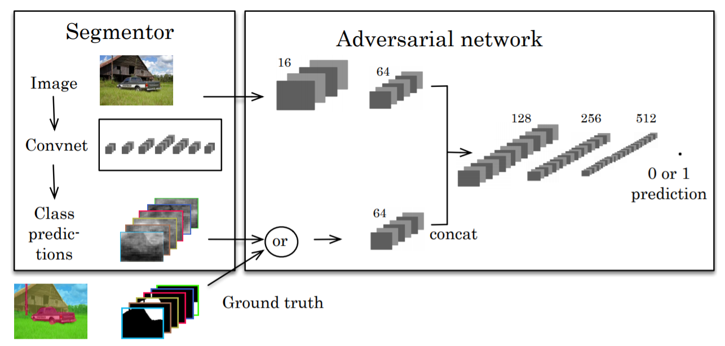
GANs for Shape-based Segmentation
We rephrase the problem to letting D classify between manual and automatic segmentations.
Generate Auto Segmentations with G
Train D on Manuals
Train D on Autos
Train G’ on Autos Pretending they are Manuals
G’
Manual
D
1
Manual
Generator
0
Auto/Synthetic
G
Discriminator
Image
Automatic
P. Luc, C. Couprie, S. Chintala, and J. Verbeek, “Semantic Segmentation using Adversarial Networks,”
arXiv:1611.08408 [cs], NIPS Workshop on Adversarial Training, Nov. 2016, Available: http://arxiv.org/abs/1611.08408.

Slide 35
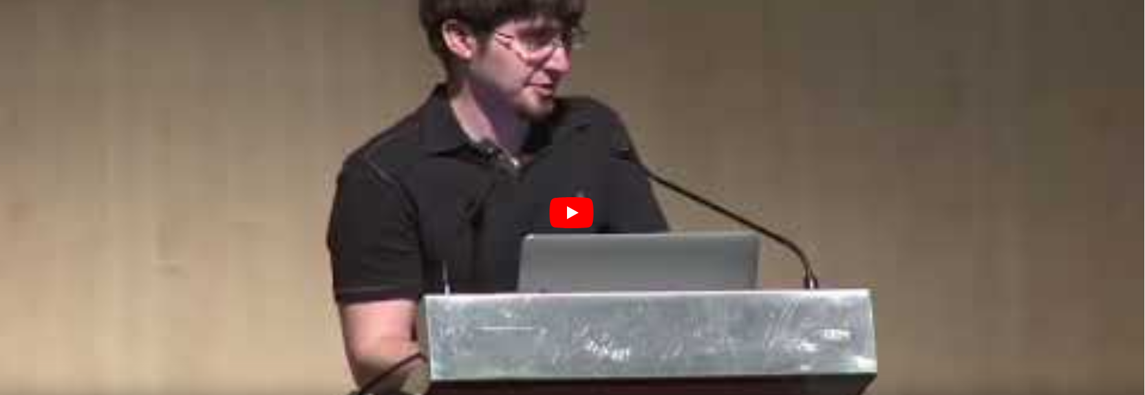
#summer-of-ai

Slide 36
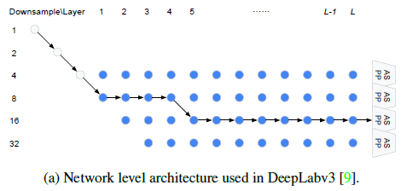
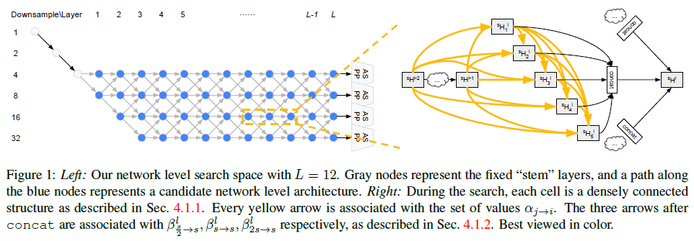
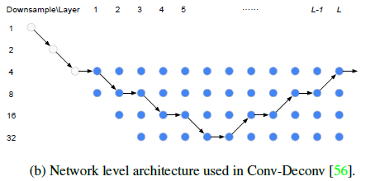
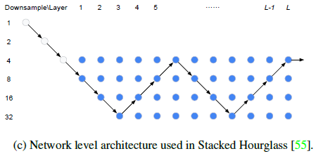
Neural Architecture Search
Neural architecture search for semantic image segmentation that can handle full resolution image input.
C. Liu et al., “Auto-DeepLab: Hierarchical Neural Architecture Search for Semantic Image Segmentation,” in 2019 IEEE/CVF Conference on Computer Vision and Pattern Recognition (CVPR), Jun. 2019, pp. 82–92, doi: 10.1109/CVPR.2019.00017.

Slide 37
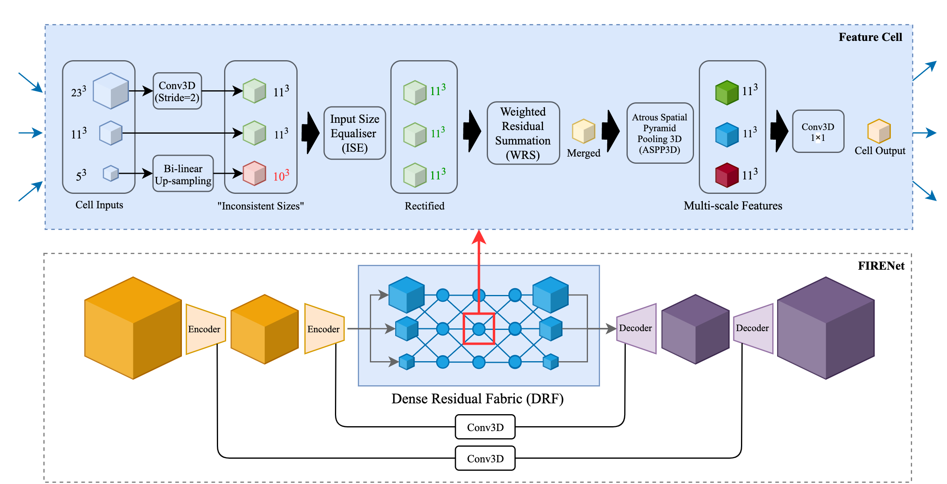
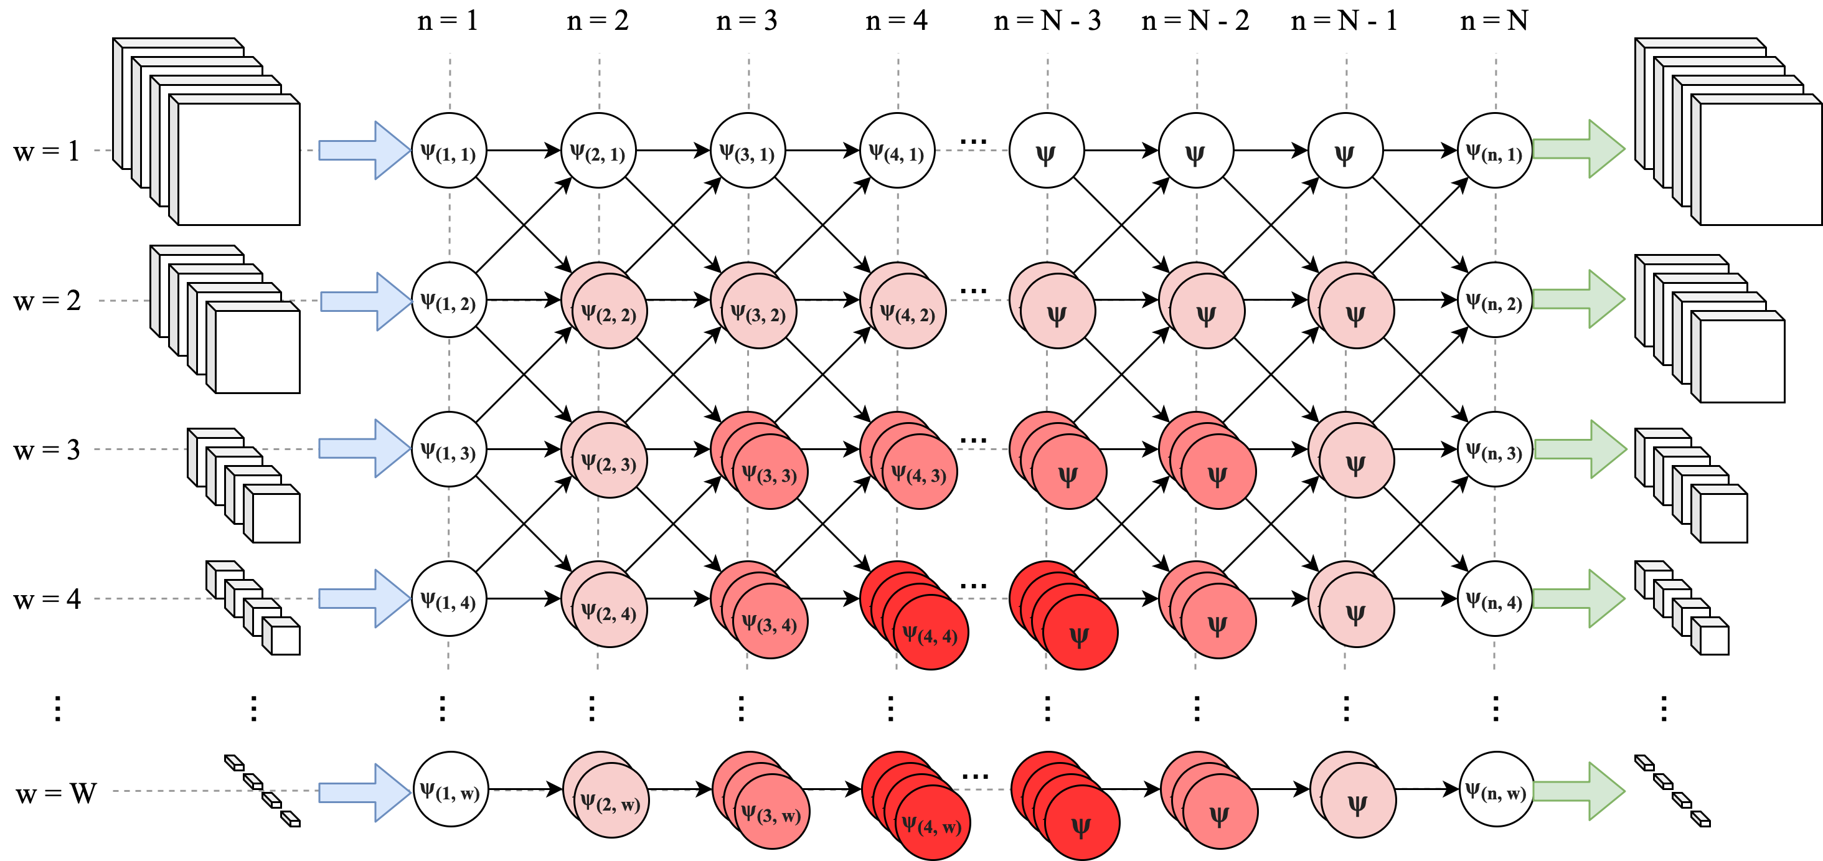

Dense Residual Fabric Networks
Neural architecture search for 3D semantic image segmentation that can handle full resolution (size-independent) 3D MRI input for multi-dataset learning and analysis.
Liu, S., Dai, W., Engstrom, C., Fripp, J., Greer, P. B., Crozier, S., Dowling, J. A., & Chandra, S. S. “Fabric Image Representation Encoding Networks for Large-scale 3D Medical Image Analysis”, ArXiv:2006.15578 [Cs, Eess] 2020. http://arxiv.org/abs/2006.15578

Slide 38

Visual Transformers
A. Dosovitskiy et al., “An Image is Worth 16x16 Words: Transformers for Image Recognition at Scale,” arXiv:2010.11929 [cs], Oct. 2020, Accessed: Dec. 10, 2020. [Online]. Available: http://arxiv.org/abs/2010.11929.

Slide 39
Conclusion
CNNs provide a way of automatically extracting meaningful features for your problem
This drastically improves performance of imaging tasks
Neural architecture search provides a way to determine the best CNN structure for the problem
Could transformers be the future for imaging?
#summer-of-ai

Slide 40


Thank you
Dr Shekhar “Shakes” Chandra | Senior Lecturer
School of Information Technology and Electrical Engineering
shekhar.chandra@uq.edu.au
+61 7 3365 8359
@shakes76
shekhar-s-chandra

